Slide 1

Note: The data and information in this document is reflective of a hypothetical situation and client. This document is to be used for KPMG Virtual Internship purposes only.
Sprocket Central Pty Ltd
Data analytics approach
[Division Name] - [Engagement Manager], [Senior Consultant], [Junior Consultant]

Slide 2
Note: The data and information in this document is reflective of a hypothetical situation and client. This document is to be used for KPMG Virtual Internship purposes only.
Agenda
Introduction
Data Exploration
Model Development
Interpretation

Slide 3
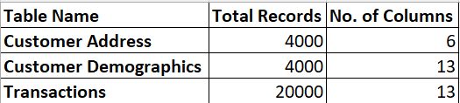
Note: The data and information in this document is reflective of a hypothetical situation and client. This document is to be used for KPMG Virtual Internship purposes only.
Introduction
Analysis on the 3 provided datasets
In our analysis, we utilized the existing datasets, including Customer Demographic, Customer Address, and Transactions, to identify potential high-value customers among the new dataset of 1000 customers.
While these results provide valuable insights, they should be considered as a starting point for further analysis and business considerations. Let's explore the findings in detail to determine the most valuable customers for the organization's growth and success.

Slide 4
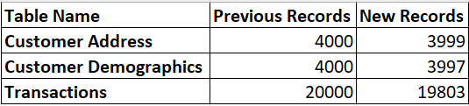
Note: The data and information in this document is reflective of a hypothetical situation and client. This document is to be used for KPMG Virtual Internship purposes only.
Data Exploration
Changes in the Existing Datasets
In our analysis, we have selectively focused on the fields that provide meaningful insights, while disregarding any irrelevant or missing information. Please find the below details that are filtered out from the existing data:
From Customer Demographics data, removed the records where DOB = “1843-12-21” (1 entry) and where deceased indicator = ‘Y’ (2 entries).
From Transactions data removed the records where product first sold date is null (197 entries).

Slide 5
Note: The data and information in this document is reflective of a hypothetical situation and client. This document is to be used for KPMG Virtual Internship purposes only.
Data Exploration
Data Cleaning
Data Cleaning Process involves below steps that are performed on the provided 3 datasets:
Handling Missing Values
Managing Inconsistent Data Formatting
Addressing Duplicate Records
Validating Data Integrity
Standardizing and Cleansing Data
Documenting Data Cleaning Steps
In the next page, we have provided the documentation for data cleaning steps that we performed on each of the 3 datasets.

Slide 6
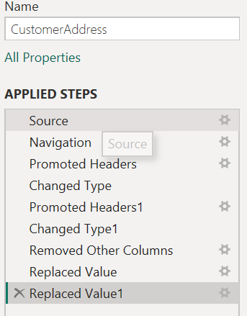
Note: The data and information in this document is reflective of a hypothetical situation and client. This document is to be used for KPMG Virtual Internship purposes only.
Data Exploration
Data Cleaning Steps for Customer Address data
Adjusting Data Types:
Converted the data types to ensure that they are appropriate for their respective data.
Standardizing State Names:
Replace variations of state names, such as "New South Wales" to "NSW" and "Victoria" to "VIC," for consistency and easier analysis.
These steps were performed specifically for the customer address data to improve data quality, ensure consistency, and facilitate accurate analysis.

Slide 7
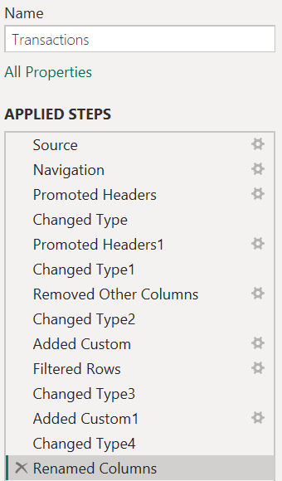
Note: The data and information in this document is reflective of a hypothetical situation and client. This document is to be used for KPMG Virtual Internship purposes only.
Data Exploration
Data Cleaning Steps for Transactions data
Added new Column Profit:
The "Profit" value was computed by subtracting the standard cost from the list price for each transaction.
Creating Transaction Month:
To analyze the data on a monthly basis, a new column, "Transaction Month," was derived from the existing "Transaction Date" column.
Removing Records with Null Product First Sold Date:
These records were removed, ensuring that only transactions with a valid product first sold date are considered for analysis.
Adjusting Data Types:
Converted the data types to ensure that they are appropriate for their respective data.

Slide 8
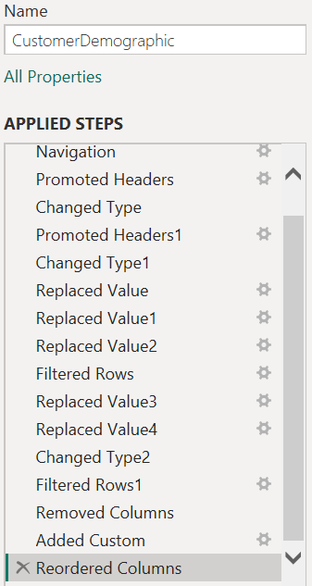
Note: The data and information in this document is reflective of a hypothetical situation and client. This document is to be used for KPMG Virtual Internship purposes only.
Data Exploration
Data Cleaning Steps for Customer Demographics data
Standardizing Gender Values:
To ensure consistency and uniformity, the gender values were replaced with "Female" for "Femal" or "F" and "Male" for "M."
Removing Invalid or Inaccurate Records:
Data records where the date of birth (DOB) was listed as "1843-12-21" were removed.
Additionally, any records with a deceased indicator marked as 'Y' were also excluded from the dataset.
Added new column Age:
The age was computed by subtracting the customer’s DOB from the current year.
Adjusting Data Types:
Converted the data types to ensure that they are appropriate for their respective data.

Slide 9
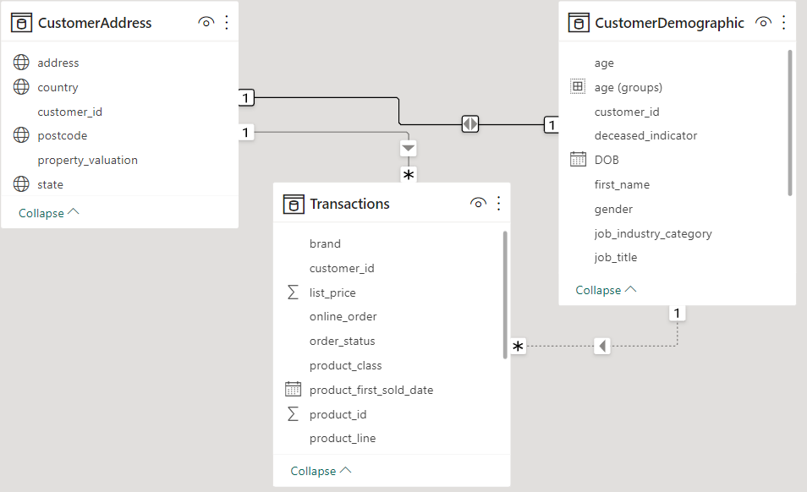
Note: The data and information in this document is reflective of a hypothetical situation and client. This document is to be used for KPMG Virtual Internship purposes only.
Model Development
Establishing the Relationship
For establishing the relationship between the existing 3 tables we need to have a common identifier, in our data we have cutomer_id which is common in all 3 data.
By using the customer_id as the common identifier, allows us to integrate the relevant information from each table into a unified dataset, enabling comprehensive analysis and modeling.

Slide 10
Note: The data and information in this document is reflective of a hypothetical situation and client. This document is to be used for KPMG Virtual Internship purposes only.
Model Development
Variable Selection for Analysis
To identify potential high-value customers among the new dataset of 1000 customers, we can look for the insights from previous data based on the mentioned variables:
Percentage of Transactions by different Age Groups.
Gender-Based Profit Analysis
State wise distribution of Transactions
Transactions based on Job Category
Transactions Based on Wealth Segment

Slide 11
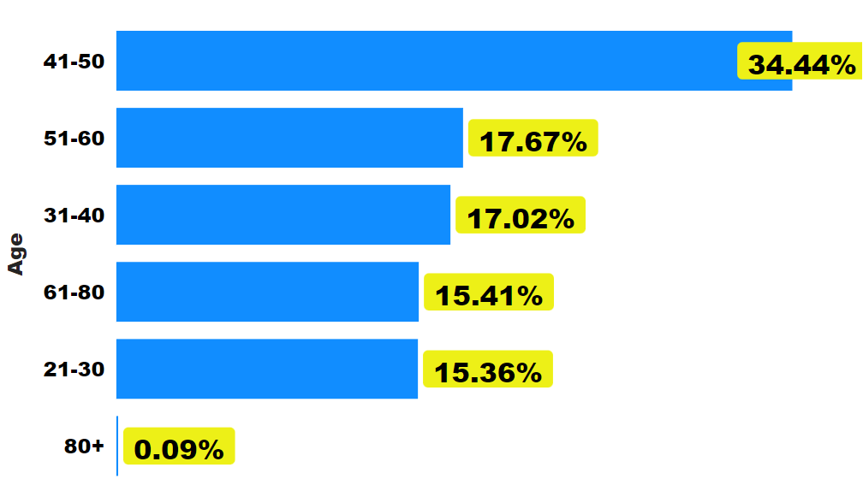
Note: The data and information in this document is reflective of a hypothetical situation and client. This document is to be used for KPMG Virtual Internship purposes only.
Interpretation
1. Percentage of Transactions by Age Groups

Slide 12
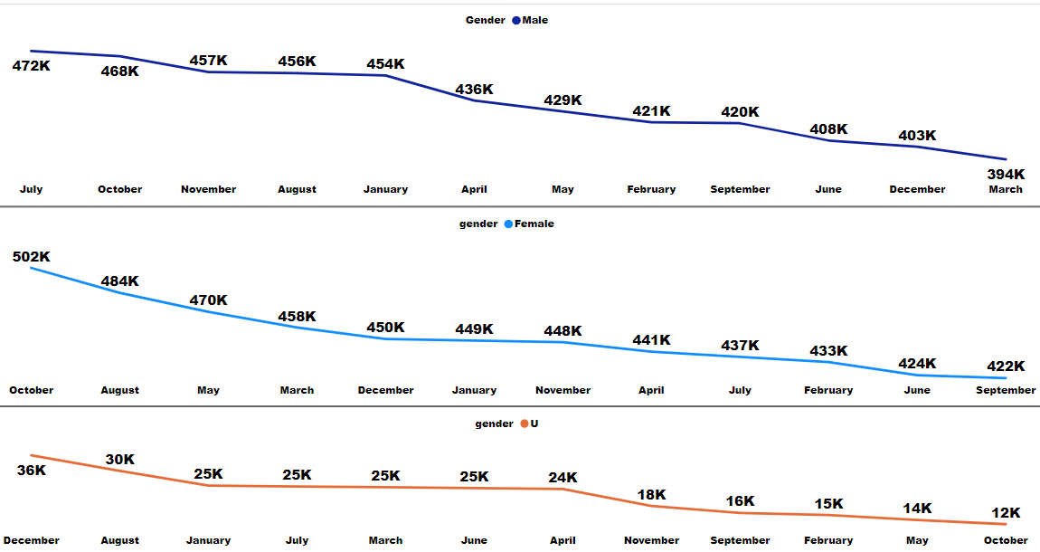
Note: The data and information in this document is reflective of a hypothetical situation and client. This document is to be used for KPMG Virtual Internship purposes only.
Interpretation
2. Gender-Based Profit Analysis and Targeting Opportunities

Slide 13
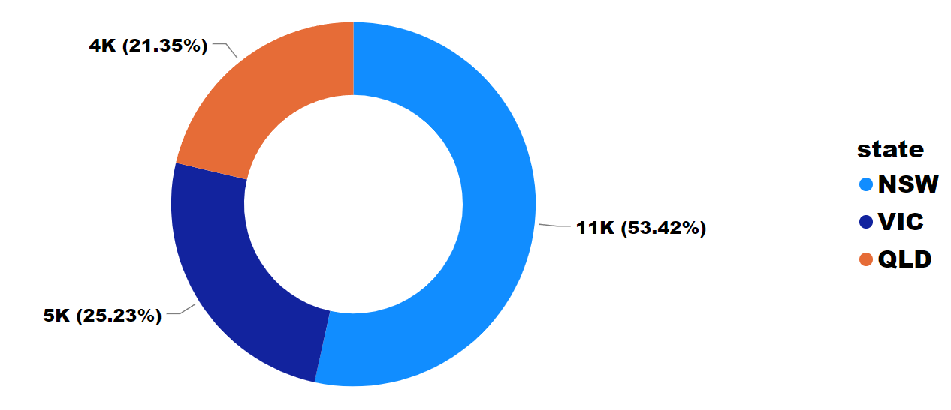
Note: The data and information in this document is reflective of a hypothetical situation and client. This document is to be used for KPMG Virtual Internship purposes only.
Interpretation
3. State wise distribution of Transactions

Slide 14
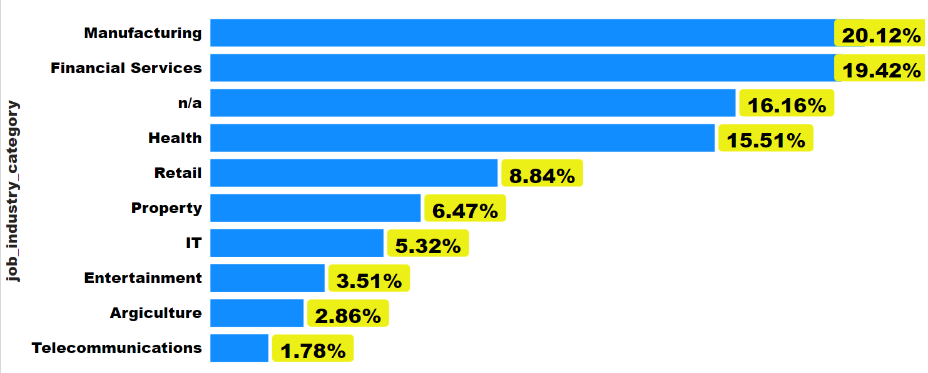
Note: The data and information in this document is reflective of a hypothetical situation and client. This document is to be used for KPMG Virtual Internship purposes only.
Interpretation
4. Transactions based on Job Category

Slide 15
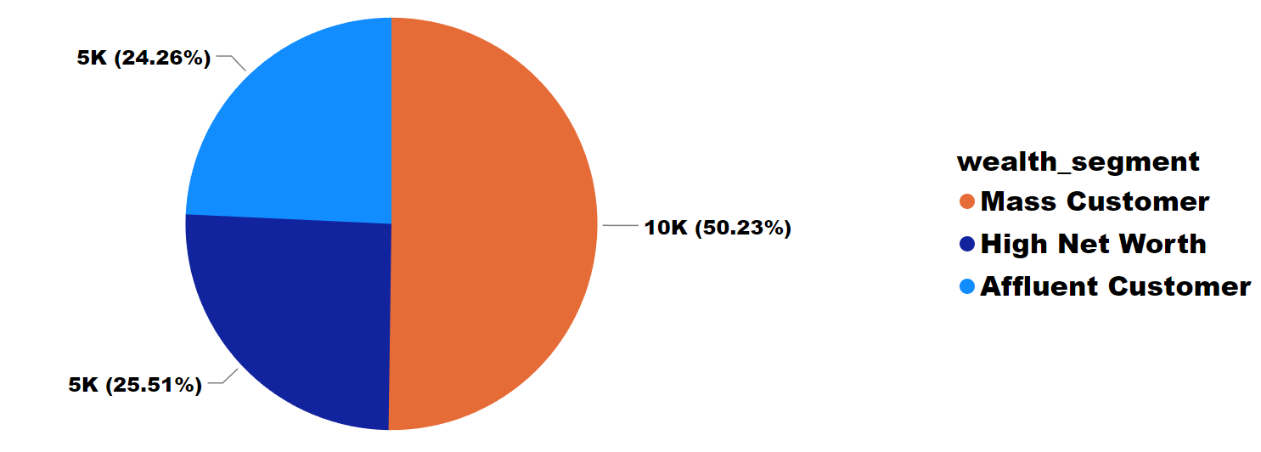
Note: The data and information in this document is reflective of a hypothetical situation and client. This document is to be used for KPMG Virtual Internship purposes only.
Interpretation
5. Transactions Based on Wealth Segment

Slide 16
Note: The data and information in this document is reflective of a hypothetical situation and client. This document is to be used for KPMG Virtual Internship purposes only.
Interpretation
Conclusion
Below mentioned Points are the conclusion that we identified as a part of our analysis that can identify the high-value customers among the new dataset of 1000 customers:
The Age group we need to target is between 41-50.
Female customers generated slightly higher profits than male customers, with October and August being the most profitable months that should be targeted.
State NSW accounts for the majority of transactions, with 53% of the total.
Manufacturing and financial services combined represent nearly 40% of total transactions, making them the top job categories.
Mass customers account for 50% of total transactions in the wealth segment.

Slide 17
Note: The data and information in this document is reflective of a hypothetical situation and client. This document is to be used for KPMG Virtual Internship purposes only.
Thank You

